Slide 1


Software Project Lab-01
Project Name : Leverage Score Sampling
Presented by :
Mahir Faisal
Roll- 1316
Supervised by :
Prof.Dr.Mohammad Shoyaib

Slide 2
Tasks that I have already completed of my project.
Overview
➤ Motivation
➤ Input a matrix from file
➤ Calculate transpose of the matrix
➤ Multiply two matrix
➤ Finding coefficients for the polynomial equation from the given matrix
➤ Calculate determinant of the matrix
➤ Solving polynomial equation
➤ Finding eigenvalues of a matrix
➤ Finding eigenvectors using Gauss elimination
➤ Implementing Jacobi rotation method for eigenvalues
➤ Calculating SVD(Singular Value Decomposition)
➤ Calculating the pseudo inverse of a matrix from SVD
➤ Calculating Leverage Scores
➤ Find out the index of highest leverage scores
➤ Creating projection matrix
➤ Generate Sample data matrix

Slide 3
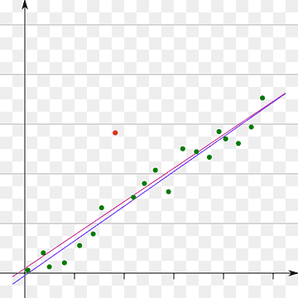
Why Leverage Score Sampling
In several sector Leverage Score Sampling is used to extract a representative subset of data points. In medical sector it is used to identify the risk factors of diseases. As the same way it helps the Marketing, Finance, Image & video processing etc.

Slide 4
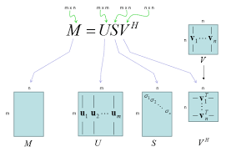
Singular Value Decomposition
Here SVD is used for Sampling a data which is considered as a matrix
Let, the data matrix is M (m🗙n), such that…
T
For square matrix m = n
M = U Σ V
Where,
U is a mxm orthonormal eigenvectors of M M
T
∑ is a m🗙n diagonal matrix of the singular values
Which are the square roots of the eigenvalues of
T
M M
T
T
V is a n🗙n orthonormal eigenvectors of M M

Slide 5
A complete task of the Project:
start
Generate random number
Transpose
Multiplication
YES
No
if n<10
Faddeev Leverrier Algo.
Jacobi rotation
Bairstow Algorithm
Gauss Elimination
Compute SVD
Pseudo Inverse
Compute Leverage Scores
Generate Representative Sample
Projection Matrix
end

Slide 6
Generate Random Number
We generate the numbers using the random number generator, rand() function
Generated random numbers are between (0-200)
min = 0, max = 200
ran = rand();
Aᵢⱼ = ran % (max-min) + min

Slide 7
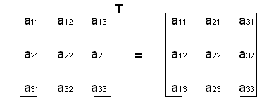
Transpose matrix calculation
T
T
Transpose matrix of M is M such that all rows of the matrix M convert to column of M
& all column convert to rows
Like,
M =
5 -8 9
-6 7 3
10 8 12
5 -6 10
-8 7 8
9 3 12
So,
M =
T

Slide 8
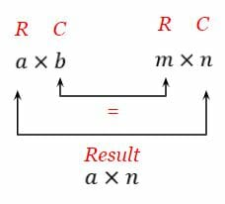
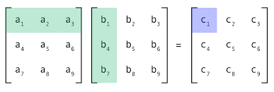
Matrix Multiplication
If we consider two matrix A(aхb) & B(mхn), then the criteria for multiplication of AB
5 -8 9
-6 7 3
10 8 12
(5x5)+(-8 x -8)+(9x9) … …
(-6x-6)+(7x7)+(3x3) … …
(10x10)+(8x8)+(12x12) … …
Let,
A =
AB =
5 -6 10
-8 7 8
9 3 12
170 -59 94
-59 94 32
94 32 308
AB =
B =

Slide 9
Process of finding Eigenvalues & corresponding Eigenvectors
First of all we have to create a polynomial equation of Eigenvalues λᵢ
the characteristic equation |w-λI| = 0 of the data matrix M
C₁λⁿ+C₂λⁿ⁻¹+… ...+Cₙ₋₁λ + Cₙ
Then calculate eigenvectors using following equation :
|w-λI|x= 0 ; where x is the eigenvectors of each eigenvalue

Slide 10
Faddeev–LeVerrier algorithm
1 0 0 … …
0 1 0 … …
0 0 1 … …
. . . . .
. . . … 1
Initialize a identity matrix, A₁ =
.
Where,
M is the given matrix
n is the dimension of the matrix M
C are the coefficients of the polynomial equation
I is an identity matrix
tr( AMm ) = trace of the matrix AMm
Then we calculate,
Am = MAm₋₁ + Cn₋m+1I
Cₙ₋m = - tr( AMm )
1
―
m
Let
M =
3 1 5
3 3 1
4 6 4
C₃ = 1
1
3 1 5
3 3 1
4 6 4
C₂ = - — ( 3+3+4)
= - 10
1 0 0
0 1 0
0 0 1
1
A₁ =
MA₁ =

Slide 11
Faddeev Leverrier(Continued)
-7 1 5
3 -7 1
4 6 -6
2 26 -14
-8 -12 12
6 -14 2
1
A₂ =
MA₂ =
C₁ = - — (-8) = 4
2
6 26 -14
-8 -8 12
6 -14 6
40 0 0
0 40 0
0 0 40
1
A₃ =
MA₃ =
C₀ = - — (120) = - 40
3
Furthermore, A₄ = MA₃ + C₀I = 0 which confirms the above calculations
It’s very glad to know that (-1)³.C₀ = 40 is the determinant of the given matrix M
It’s also an interesting part that the inverse of the given matrix is ( - 1/C₀).A₃
So, M⁻¹ = (-1/(-40)).A₃
3/20 13/20 -7/20
-1/5 -1/5 3/10
3/20 -7/20 3/20
M⁻¹ =

Slide 12
Bairstow algorithm
Initial equation
C₁λⁿ+ C₂λⁿ⁻¹+... …Cₙ₋₁λ+ Cₙ
Divide polynomial equation by a quadratic equation
(C₁λⁿ+ C₂λⁿ⁻¹+... …Cₙ₋₁λ+ Cₙ) / (λ²+ pλ+ q)
Reminder = 0
No
Yes
λ²+ pλ+ q = 0
Y es
-p +√(p² -4q)
λ =
-
2
C₁λⁿ⁻²+ C₂λⁿ⁻³+ … Cₙ₋₂
Two roots

Slide 13
Bairstow algorithm (continued)
The quadratic equation x²+ px + q = 0 starts with a initial guess p & q, then it will change iteratively
Initial, p = (aₙ₋₁/aₙ), q = (aₙ₋₂/aₙ), if(p = 0) p=0.1, if(q=0) q=0.1
b is the array such that…
bₙ = aₙ
bₙ₋₁ = aₙ₋₁ + bₙ* p
Another array c such that…
cₙ =bₙ
cₙ₋₁ = bₙ₋₁ + cₙ* p
for i = (n-2) to 0
bᵢ = aᵢ + ( bᵢ₊₁ * p ) + ( bᵢ₊₂ * q )
Iterative approach for changing p,q
b₀c₃ - b₁c₂
p’ = p, q’ = q
△p =
c₂c₂ - c₁c₃
p = p + △p
q = q + △q
b₁c₁ - b₀c₂
△q =
c₂c₂ - c₁c₃

Slide 14
Bairstow algorithm (continued)
Root finding
PrintRoot(double x, double y, double z)
else while(1)
cal_col(a,b) ; cal_col(b,c) ;
cal_p_q() ;
ratio_p = △p/p’ ; ratio_q = △q/q’;
if(abs(b₀<=phi) & abs(b₁<=phi) or
abs(ratio_p<=phi) or abs(ratio_q<=phi))
call-> printRoot(1,p,q) ;
if(n=4) last = true ;
call-> printRoot(bₙ,bₙ₋₁,bₙ₋₂) ; break ;
if(n=3) root = bₙ₋₁/ bₙ ; break ;
call-> reduce_equation() ;
determine = (y*y) - 4*x*z ;
if(determine>0)
determine = sqrt( determine) ;
root_1 = remove_error(((-y) - determine) / (2*x)) ;
root_2 = remove_error(((-y) + determine) / (2*x)) ;

Slide 15
Gauss Elimination
Let, the linear equation
x - 2y = -4
-5y + z = -9
4x - 3z =-10
Consider a Augmented Matrix Ab
Augmented Matrix
for (i=0; i<MAX_ROW; i++) {
for (k=i+1; k<MAX_ROW; k++) {
M = -Ab[k][i]/Ab[i][i];
for (j=i; j<MAXCOL+1; j++) {
Ab[k][j] = Ab[k][j] + M*Ab[i][j];
}
}
}
Ab =
1 -2 0 -4
0 -5 1 -9
4 0 -3 -10
After applying Gauss elimination…
1 -2 0 -4
0 -5 1 -9
0 0 -7 -42
Ab =
Back Substitution:
z = -42/-7 = 6
y = 3, x = 2
So, variables…
x = 2
y = 3
z = 6

Slide 16
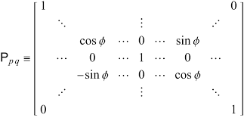
Jacobi Rotation Method
In order to calculate eigenvalue for high dimension, we use jacobi iteration.
do {
flag= 0;
p=0; q=1;
max= fabs(d[p][q]);
if(d[p][p]==d[q][q]) {
if (d[p][q] > 0)
theta= pi/4;
else
theta= -pi/4;
}
else {
theta=0.5*atan(2*d[p][q]/(d[p][p]-d[q][q]));
}

Slide 17

Procedure of computing SVD of the given matrix M
First of all we compute the right Eigenvector by finding eigenvalues of w = M M
T
Solving characteristic equation |w-λI| = 0
We find n eigenvalues & eigenvectors Vᵢ for the corresponding eigenvalues
Now, create the right singular vector V such that …
[ V₁ V₂ … … … Vₙ ]
V =
[ V₁ V₂ … … … Vₙ ]
T
T
T
T
So, V =

Slide 18
For calculating diagonal matrix ∑, we need n singular values which are the square
Root of the eigenvalues of M M
T
If the eigenvalues of M M are λ₁, λ₂ … … λₙ, then the singular values are σ₁,σ₂ … … ,σₙ
T
Where σᵢ = √λᵢ
σ₁
0
0 …
Left singular factor U :
∑ =
0
σ₂
0 …
.
.
.
.
.
.
. …
. …
U = A* Vт* S⁻¹
where S⁻¹ is the Inverse of the singular matrix
. σₙ
Computing SVD :
SVD(A) = U* Σ* Vт
This resulting matrix is either equal or very close to original matrix A

Slide 19
Pseudo Inverse using SVD
Pseudo Inverse is a generalization of the matrix inverse for non-square matrices or matrices that are not invertible. It is commonly computed using SVD of a matrix
Pseudo inverse of A, denoted as A⁺ such that :
A⁺ = V* S⁻¹* Uт
Leverage Scores
for(int i=0;i<Dimen;i++){
double sum = 0;
for(int j=0;j<Dimen;j++){
sum = sum + pow(U[i][j],2);
}
lvs[i] = sum;
leverage score = ||Uᵢ|| ;
where ||Uᵢ|| indicates l2 norm of each row of U

Slide 20
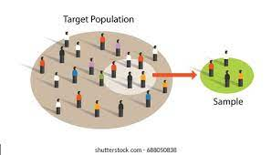
Generate representative sample
Now we find out the index of the highest leverage scores
for(int i=0;i<Dimen;i++){
rowwise_sum = rowwise_sum + lvs[i];
if(rowwise_sum/total_sum >= 0.95){
count++;
break;
}
else
count++;
}
for(int i=0;i<count;i++){
for(int j=0;j<Dimen;j++){
if(lvs[i] == arr[j])
indx_of_high_lvs[i] = j;
}
}

Slide 21
Projection Matrix
we take only those rows which are correspond by the index of highest leverage scores to generate a mхn dataset containing most important feature which called as a Projection matrix
ind = count-1, ind2 = count-1,ind3 = 0;
for(int i=0;i<count;i++){
for(int j=0;j<Dimen;j++){
U_k[j][i] = U[indx_of_high_lvs[ind]][j];
V_k[j][i] = V[indx_of_high_lvs[ind]][j];
sample[i][j] = A[indx_of_high_lvs[ind3]][j];
}
ind--;
ind3++;
}
for(int i=0;i<count;i++){
for(int j=0;j<Dimen;j++){
SkVkt[i][j] = S_k[i][i]*Vt_k[i][j];
}
}

Slide 22
Challenges Faced
➤ Mathematical notation conversion to code
➤ Finding coefficients for polynomial(characteristic) equation
➤ Calculating eigenvalues from the polynomial equation
➤ Solving eigenvectors for corresponding eigenvalues
➤ Iteratively rotating the matrix for finding eigenvalues
➤ Define orthonormal vectors
➤ Find out the indexes of highest leverage scores
➤ Handling big line of code for the first time
Lines of code
1470+

Slide 23
Thank You

